Slide 1
Shavuos presentation Ann Arbor June 8th, 2019
Face-to-Face
Ken Harrow, Kehillat Israel, Lansing MI

Slide 2
Chabad on Shavuos
“The giving of the Torah was a far-reaching spiritual event—one that touched the essence of the Jewish soul for all times. Our sages have compared it to a wedding between G‑d and the Jewish people. Shavuot also means “oaths,” for on this day G‑d swore eternal devotion to us, and we in turn pledged everlasting loyalty to Him.
In ancient times, two wheat loaves would be offered in the Holy Temple on Shavuot. It was also at this time that people would begin to bring bikkurim, their first and choicest fruits, to thank G‑d for Israel’s bounty.”
https://www.chabad.org/library/article_cdo/aid/609663/jewish/What-Is-Shavuot-Shavuos.htm

Slide 3
Leviticus on gleaning
In Leviticus we read, "And when ye reap the harvest of your land, thou shalt not wholly reap the corners of thy field, neither shalt thou gather the gleanings of thy harvest. And thou shalt not glean thy vineyard, neither shalt thou gather every grape of thy vineyard; thou shalt leave them for the poor and the stranger: I am the Lord your God" (Lev. xix. 9, 10). This injunction is intended for the landowners; they are the interlocutors.

Slide 4
Millet, The Gleaners

Slide 5
Chabad on giving of torah
“The giving of the Torah was a far-reaching spiritual event—one that touched the essence of the Jewish soul for all times. Our sages have compared it to a wedding between G‑d and the Jewish people. Shavuot also means “oaths,” for on this day G‑d swore eternal devotion to us, and we in turn pledged everlasting loyalty to Him.”

Slide 6
Hosea, Chapter 2
4Strive with your mother, strive, for she is not My wife, and I am not her Husband, and let her remove her harlotries from her face and her adulteries from between her breasts.
5Lest I strip her naked and leave her as [on] the day she was born; and I make her like a desert, and I set her like an arid land, and cause her to die of thirst.
6And I will not pity her children for they are children of harlotries.
7For their mother played the harlot; she who conceived them behaved shamefully, for she said, "I will go after my lovers, those who give my bread and my water, my wool and my flax, my oil and my drinks. "
8Therefore, behold I will close off your way with thorns, and I make a fence against her, and she shall not find her paths.
9And she shall pursue her lovers and not overtake them, and she shall seek them and not find them; and she shall say, "I will go and return to my first Husband, for it was better for me then than now.
10But she did not know that I gave her the corn, the wine, and the oil, and I gave her much silver and gold, but they made it for Baal….
12And now, I will bare her disgrace before the eyes of her lovers, and no man shall save her from My hand… [go to next page]

Slide 7
Hosea chapter 2
19And I will remove the names of the baalim from her mouth, and they shall no longer be mentioned by their name.
20And I will make a covenant for them on that day with the beasts of the field and with the fowl of the sky and the creeping things of the earth; and the bow, the sword, and war I will break off the earth, and I will let them lie down safely.
21And I will betroth you to Me forever, and I will betroth you to Me with righteousness and with justice and with loving-kindness and with mercy.
22And I will betroth you to Me with faith, and you shall know the Lord.

Slide 8
Face to face
Face to face

Slide 9
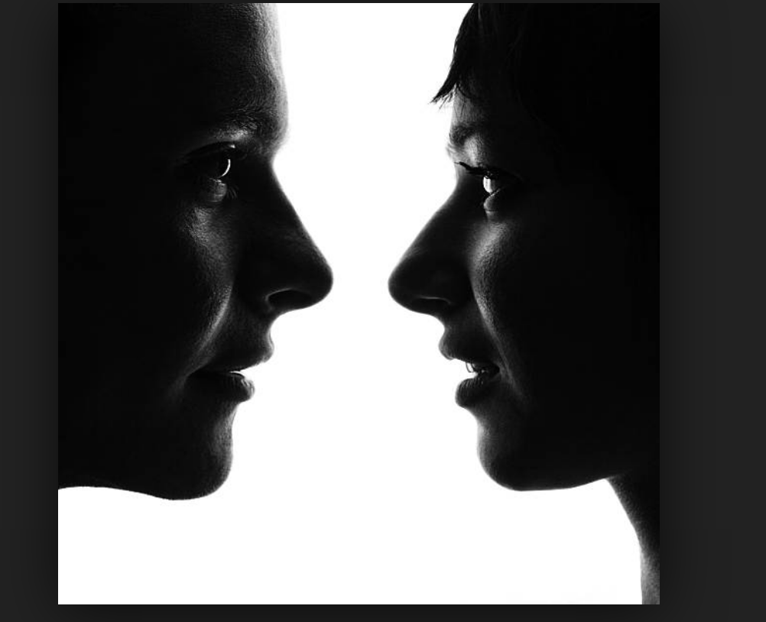
Face to face

Slide 10
Face to face

Slide 11
Ghirlandaio: The Old Man and his Grandson

Slide 12
Van Gogh self portrait

Slide 13
Rembrandt self portrait

Slide 14
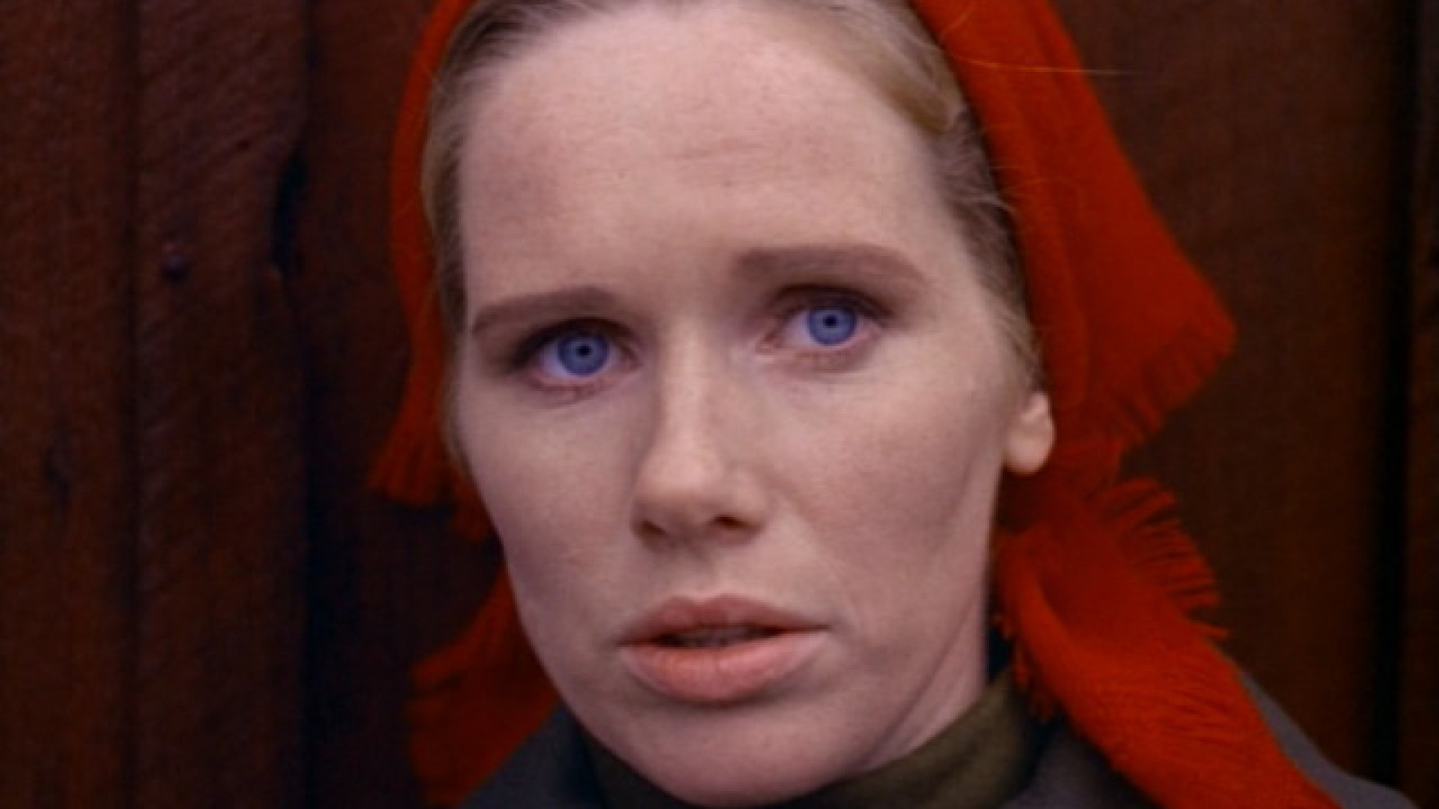
Liv Ullman, Persona

Slide 15
Rembrandt, Return of the Prodigal Son

Slide 16
Michelangelo’s portrait of isaiah, sistine chapel

